Slide 1

Diversity and Using Inclusive Language
Naymara thornton

Slide 2
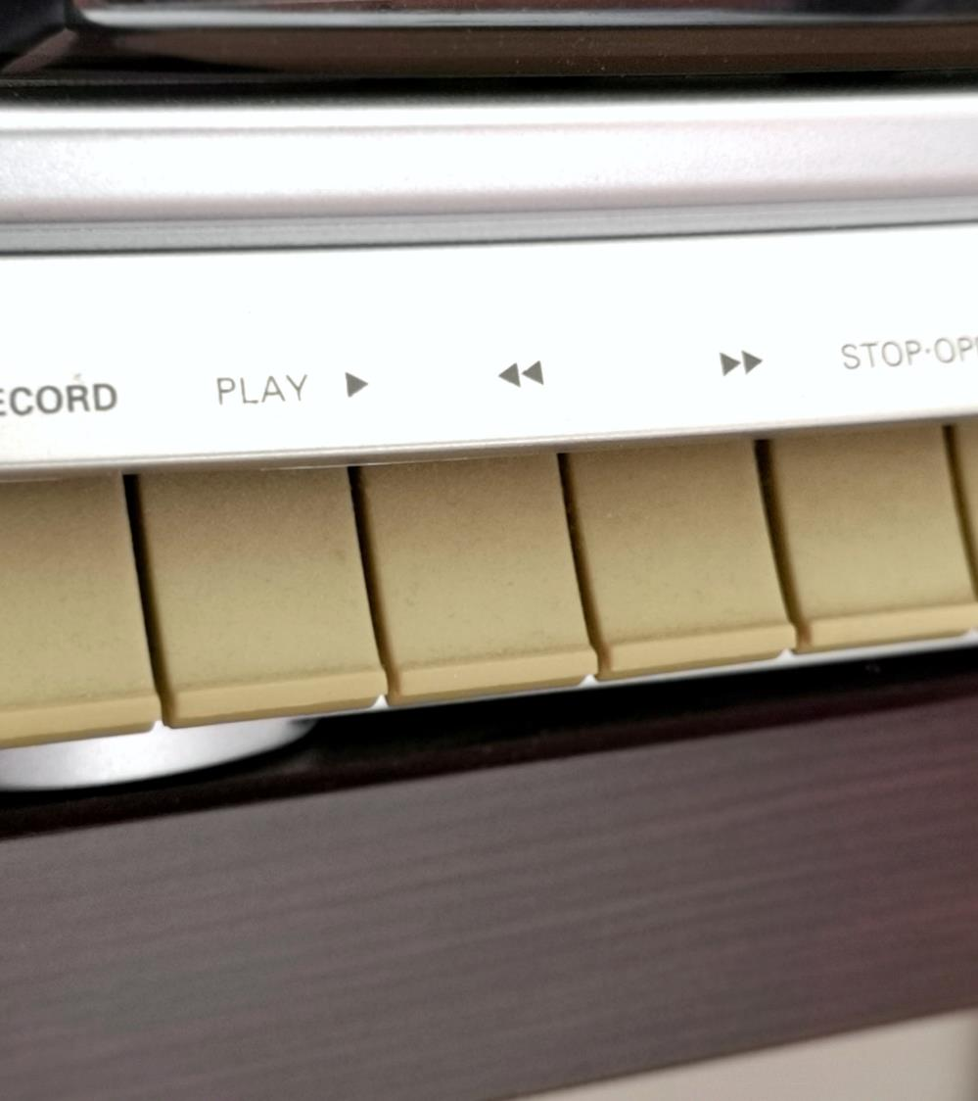
Importance of diversity and inclusive language in the work place
The purpose of diversity and inclusive language in the workplace is to foster an environment where individuals from various backgrounds, cultures, and identities feel respected, valued, and included. It recognizes diverse individuals' unique perspectives and contributions and seeks to create a fair and equitable workplace for everyone.
A

Slide 3

Understanding Inclusive Language

Slide 4
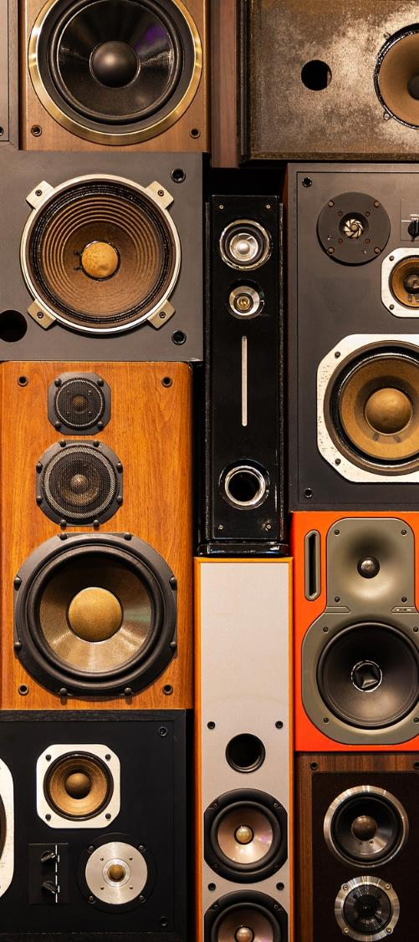
Understanding the definition and importance of Inclusive Language
Definition of inclusive language
  Language that avoids exclusion, bias, or discrimination towards individuals or groups based on characteristics such as race, age, sexual orientation, gender identity, and disability
Importance of using inclusive language
  Fosters a positive and respectful work environment, promotes diversity and inclusion, enhances communication and collaboration
4

Slide 5




Guidelines for using inclusive language when addressing race and ethnicity:
Use specific terms like African American, Asian, Hispanic, etc., instead of generic terms like “minorities
Avoid stereotypes and generalizations
Respect preferred terms and self-identifications
Incorrect usage:
“He’s a credit to his race.”
Correct usage:
  He’s a credit to his community.”

Slide 6
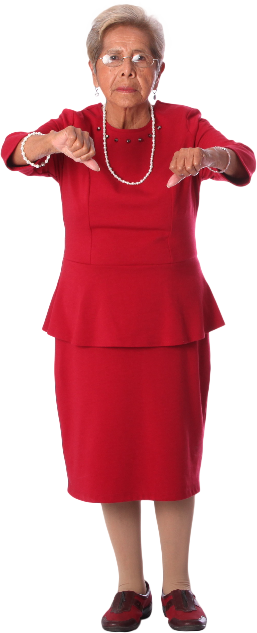



Inclusive Language for Age
Guidelines for using
Avoid making assumptions
Focus on Individual
Incorrect Usage:
inclusive language when addressing age
Based on age
Use neutral terms like “older adults” instead of “elderly” or “seniors”
capabilities and experiences, not age stereotypes
“She’s too old to learn new technology.”
Correct Usage:
“She has a wealth of experience and is eager to learn new technology.”

Slide 7








Inclusive Language for Sexual Orientation and Gender Identity
Guidelines for using inclusive language when addressing sexual orientation and gender identity:
Respect
Avoid
Use inclusive terms
preferred pronouns and gender identities
assumptions and stereotypes
like “partner” instead of assuming heterosexual relationships
Incorrect Usage
Correct Usage
“Why don’t you have a boyfriend? Are you a lesbian?”
“Tell me about your partner. Are they a great support to you?”

Slide 8

Inclusive Language for Disability
Use person-first language (e.g., person with a disability) instead of defining individuals solely by their disability
Avoid derogatory terms and negative language
Focus on abilities and accomplishments rather than limitations
Incorrect Usage: "He's confined to a wheelchair."
Correct Usage: "He uses a wheelchair for mobility."

Slide 9

Conclusion
Diversity and inclusive language are fundamental for creating a fair, just, and harmonious society where everyone can thrive and contribute their unique talents and perspectives. By embracing diversity and using inclusive language, we foster inclusivity, equality, and social progress.
Remember, incorporating inclusive language is about respecting others, fostering understanding, and creating a more inclusive society. By consciously choosing your words, you can contribute to positive change and help build a more welcoming and inclusive environment for everyone.
I'm here to answer your questions and engage in a discussion. Feel free to ask me anything or share any topic you'd like to discuss.

